Slide 1
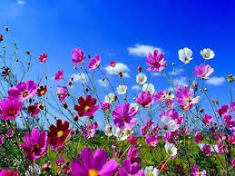
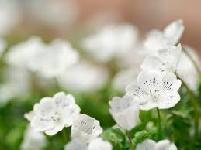
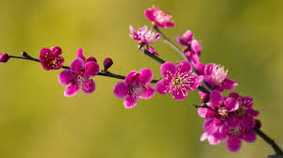
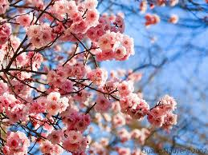
WELCOME TEACHERS TO OUR CLASS- 11A1

Slide 2



Name of the holidays/celebrations
41
60
59
58
57
56
55
54
53
52
50
49
48
47
46
45
44
43
42
40
39
38
37
36
35
34
33
32
30
29
28
27
26
25
24
23
22
21
20
19
18
17
16
15
14
13
12
11
10
9
8
7
6
5
4
3
2
1
0
51

Slide 3
Name of the holidays/celebrations
1. Lunar New Year
2. Mid-Autumn Festival
3. Thanksgiving Day
4. Women’s Day
5. Teacher’s Day
6. Halloween
7. Christmas Day
8. Valentine’s Day
9. Children’s Day

Slide 4
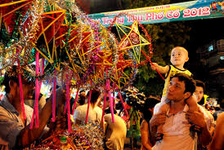

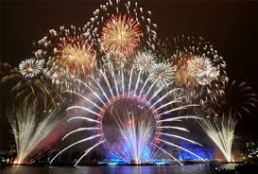
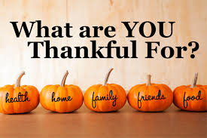
Unit 8. CELEBRATIONS
B. SPEAKING

Slide 5
Unit 8. CELEBRATIONS
B. SPEAKING
1/. Pre speaking: vocabulary
2/. While speaking: Task 1/ Groups’ presentation
3/. Post speaking: some experiences

Slide 6
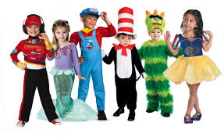
Topic: Talk about some holidays / celebrations
I. Pre-speaking:
* Vocabulary:
Dress up (v):
Mặc trang phục (hóa trang)

Slide 7
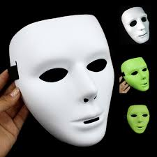
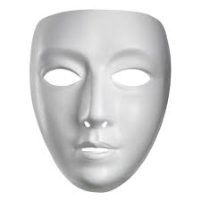
Mask (n):
Mặt nạ

Slide 8
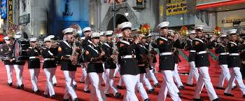
Parade (v):
Đi diễu hành

Slide 9
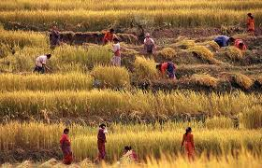
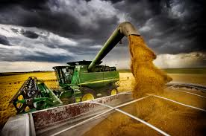
Mùa gặt,
vụ thu hoạch
Harvest (n):

Slide 10
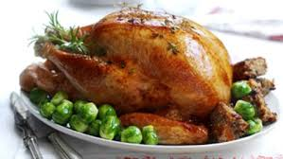
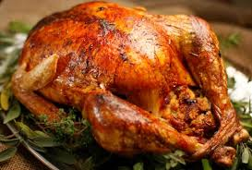
Roast turkey:
Gà tây quay

Slide 11
* Vocabulary:
Dress up [dres ʌp] (v): mặc trang phục /hóa trang
Mask [mɑ:sk] (n): mặt nạ
Parade [pə'reid] (v): đi diễu hành
Harvest ['hɑ:vist] (n): mùa gặt, vụ thu hoạch
Roast turkey [roust 'tə:ki]: gà tây quay

Slide 12
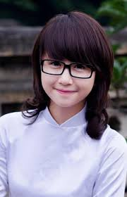
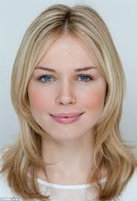
II. While-speaking
Task 1: Mai is talking with Anna, her new
English friend, about Tet holiday in Vietnam.
Work in pairs. Practice reading the dialogue.
Mai
Anna

Slide 13
Do you know that Tet holiday is next month?
What is Tet?
It’s the time when Vietnamese people celebrate the
beginning of spring. It’s also the start of the lunar
new year.
When is it exactly?
Well, this year it’s on the 9th of February.
What do you usually do at Tet?
Well, we eat a lot of special foods, we dress up and
visit friends and relatives, and we also play some
traditional games.
Oh, that sounds really interesting.

Slide 14
Model:
A: What is ……………(holiday/celebration)?
B: It’s the time when ………………….(purpose).
A: When is it exactly?
B: Well, it’s on ……………………….(date).
A: What do people usually do on/at…………………. (holiday/celebration)?
B: Well, ……………………………..(activities).
A: Oh, that sounds really interesting.

Slide 15
Task 2:Work in group, talking about some holidays or cebrations in the world

Slide 16
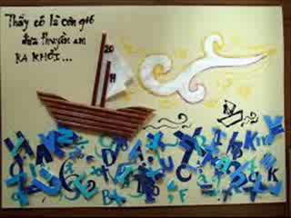
III. Post-speaking

Slide 17

Homework:
- Practice speaking at home about the celebrations/holidays

